Slide 1
Internship Title : Smart Agriculture system based on IoT - SB44294
Project ID:SPS_PRO_101
Project Title : Smart Agriculture system based on IoT
Duration:16.2 Days
Project Manager : Vaishnavi Kshirsagar.

Slide 2
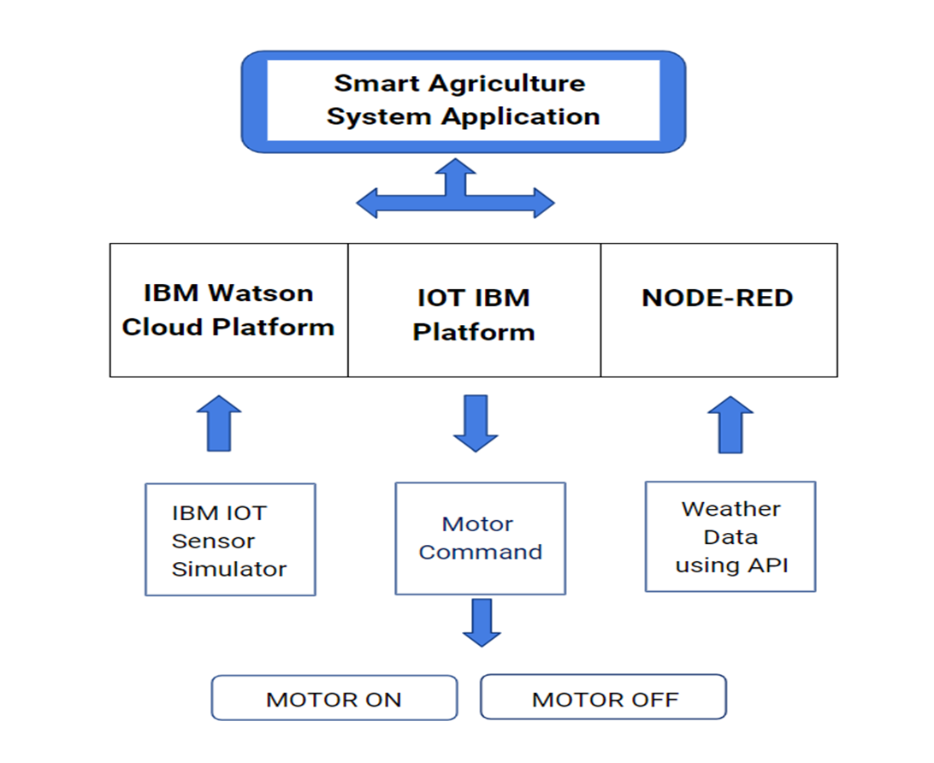
PROJECT OBJECTIVE
The objective of the project team is to build an application based on smart agriculture system.
This application gives real time weather data of any place, controlling of the motors and helps farmers in their work to grow good crops and increase the production.
BLOCK DIAGRAM

Slide 3
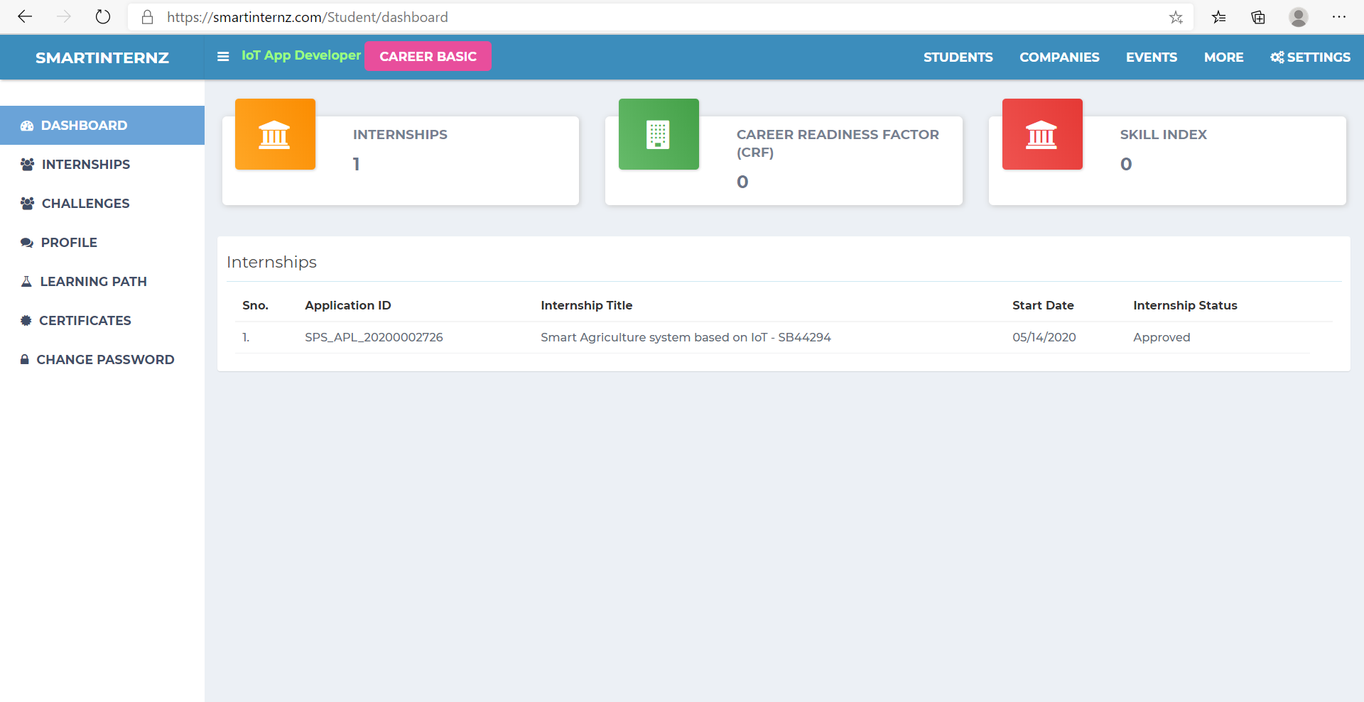
SMARTINTERNZ DASHBOARD

Slide 4
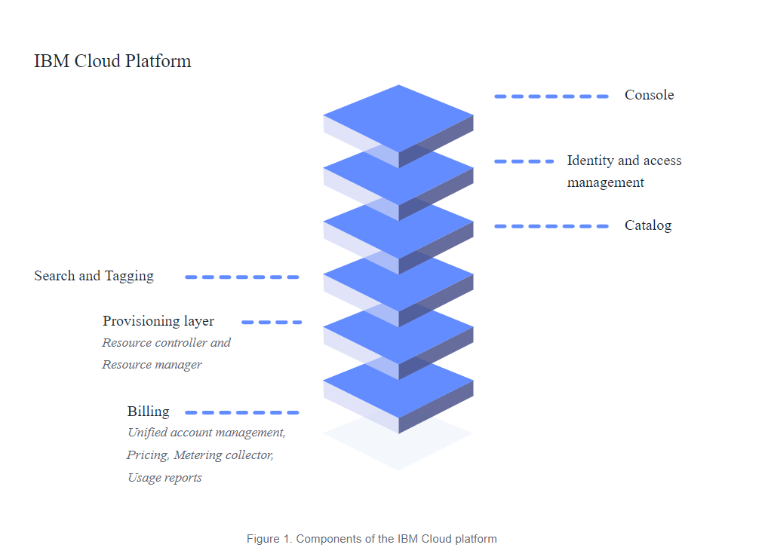
IBM CLOUD

Slide 5
UI
A user interface is the point of human-computer interaction and communication on a device, webpage, or app.
This can include display screens, keyboards, a mouse, and the appearance of a desktop.
User interfaces enable users to effectively control the computer or device they are interacting with.
A successful user interface should be intuitive, efficient, and user-friendly.
User interface elements are the parts we use to build interactive websites or apps.
They provide touchpoints for the user, from buttons to scrollbars, to menu items.
Input controls allow users to input information into the system.

